Slide 1

Sustainable business practice as a competitive advantage
Notes:
Martin Janáček (SAP), Barbora Geršlová (IKEA), Petr Vítek (Impact Hub), Johannes Naimer-Stach (EIT KIC Climate), Zdeněk Chocholáček (Sonnentor).

Slide 2


Slide 3
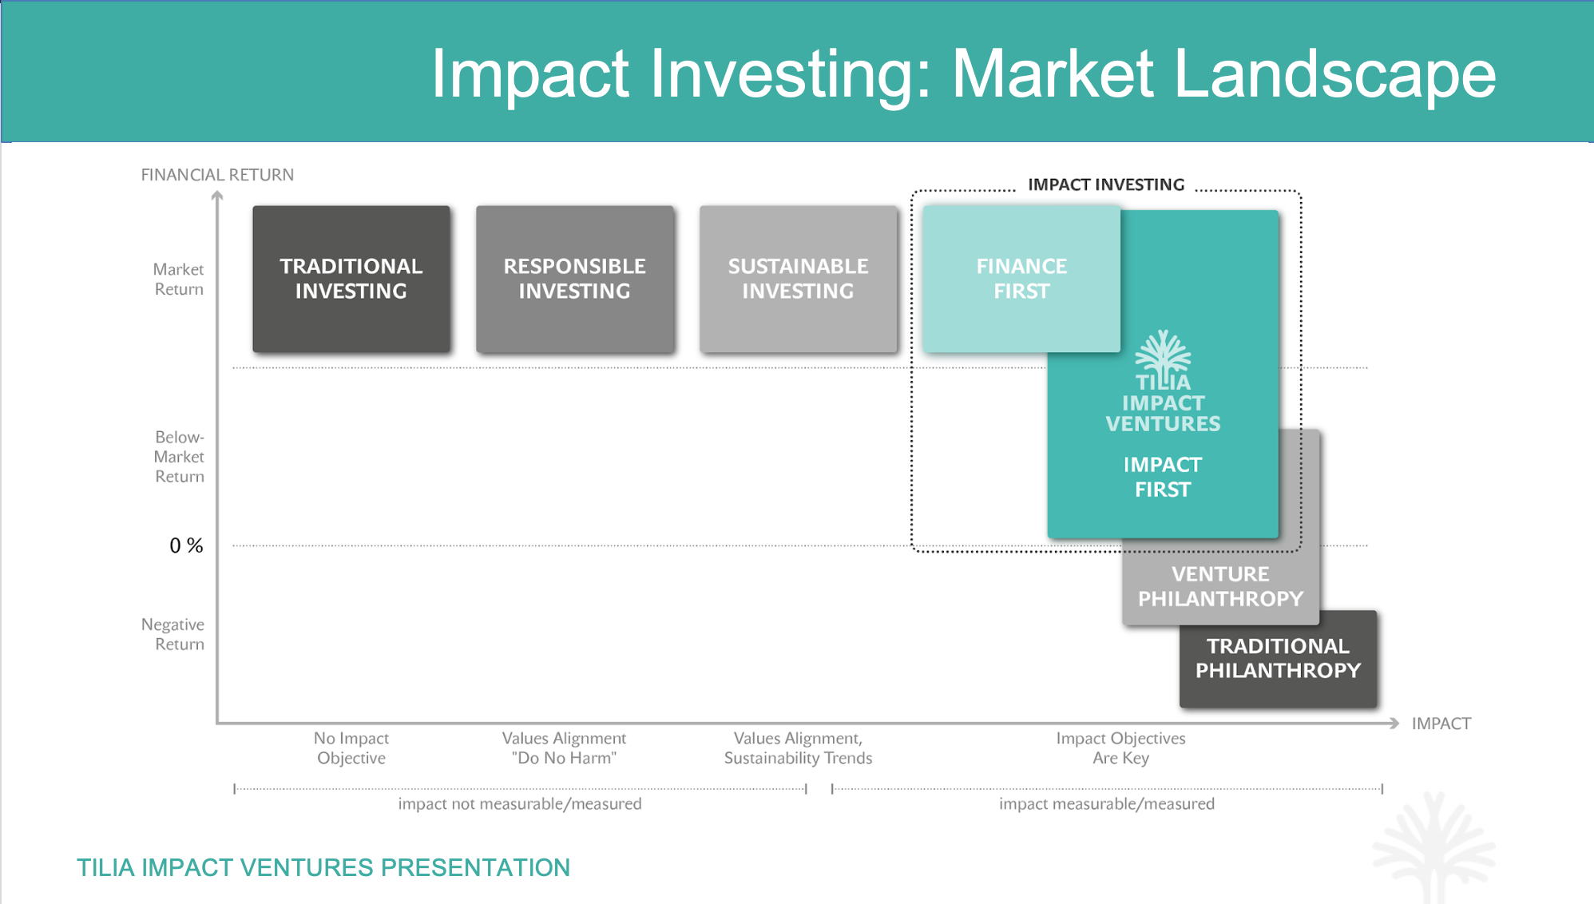

Slide 4
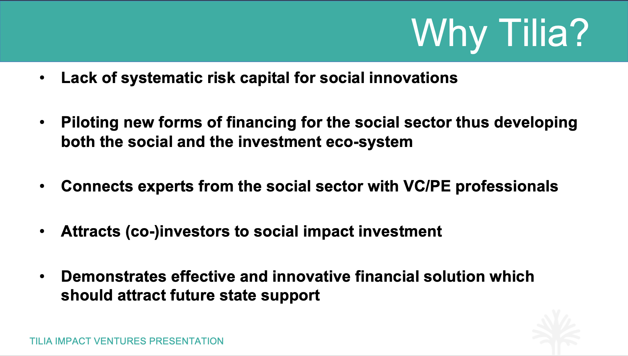

Slide 5
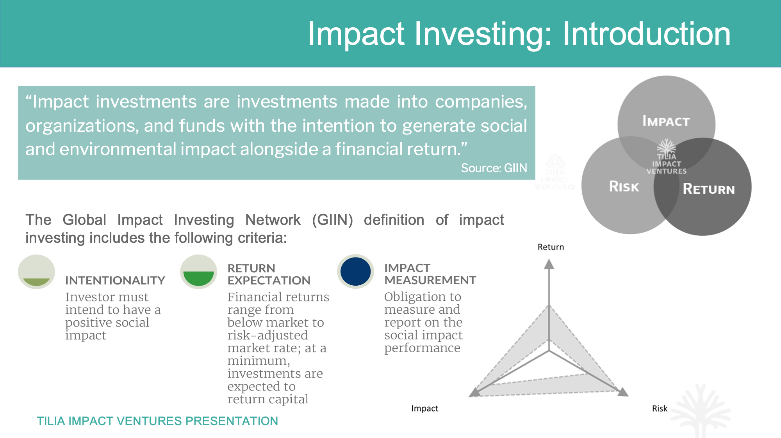

Slide 6
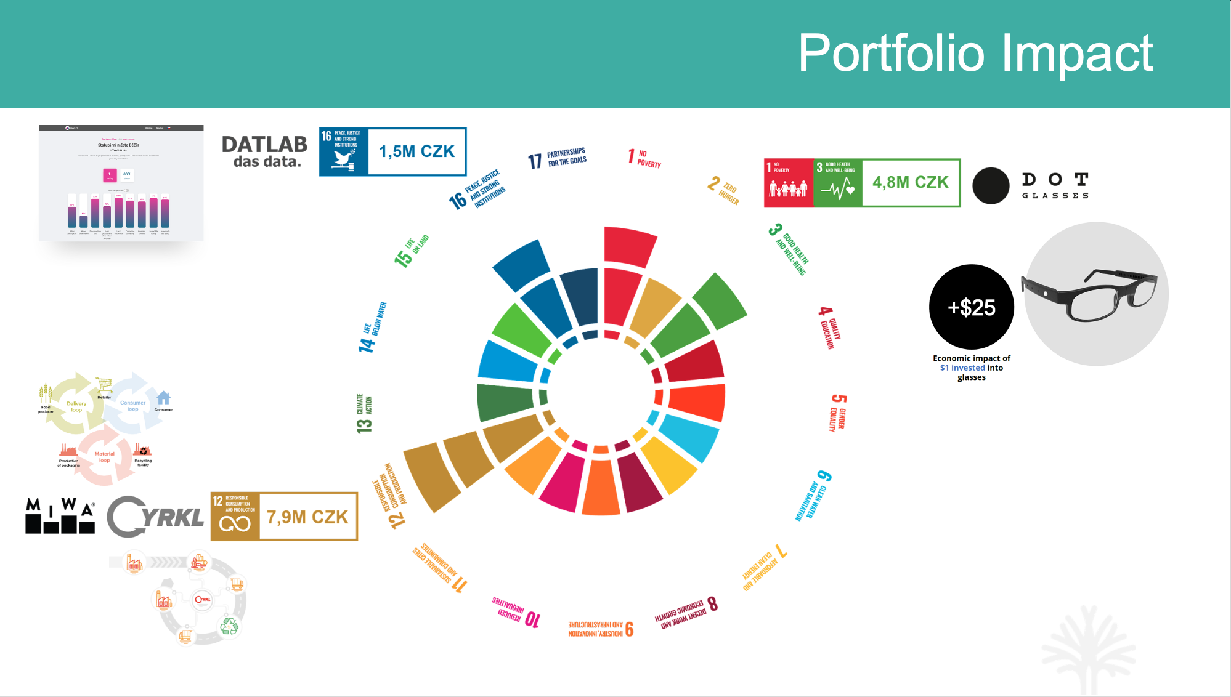

Slide 7
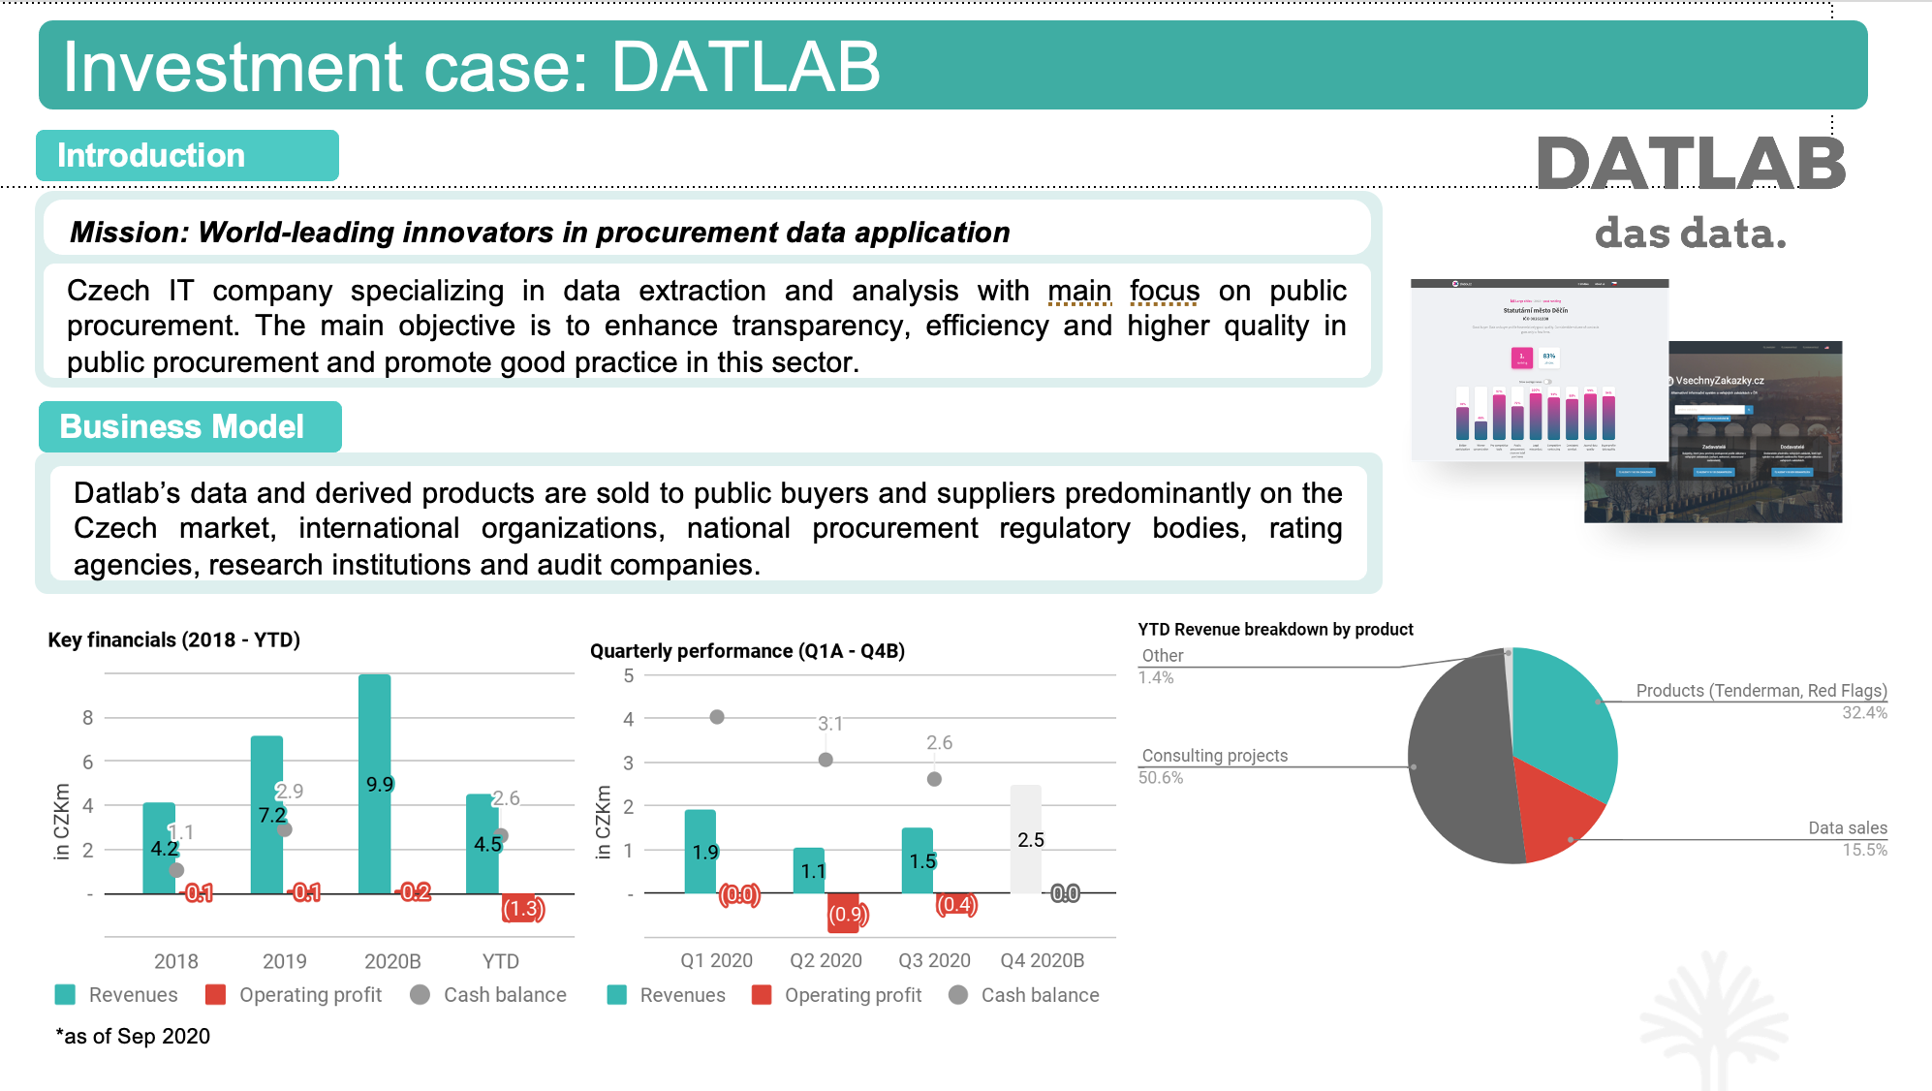

Slide 8
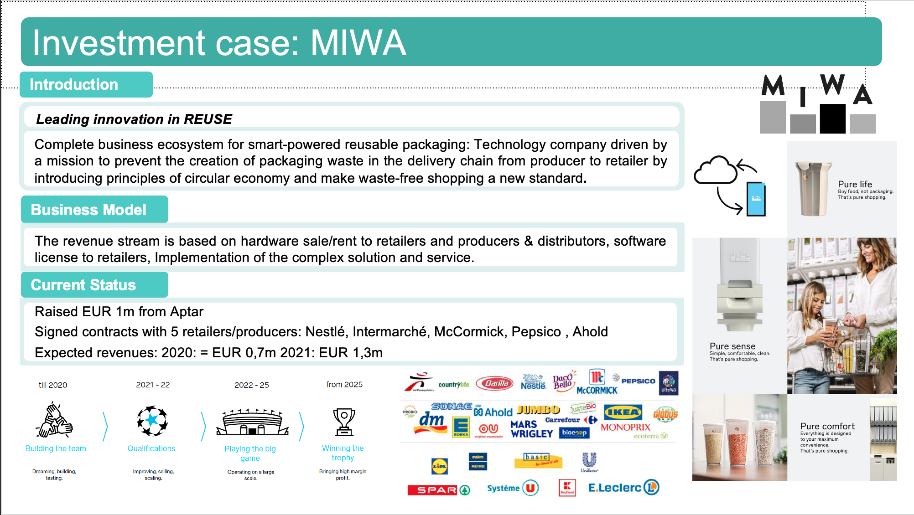

Slide 9
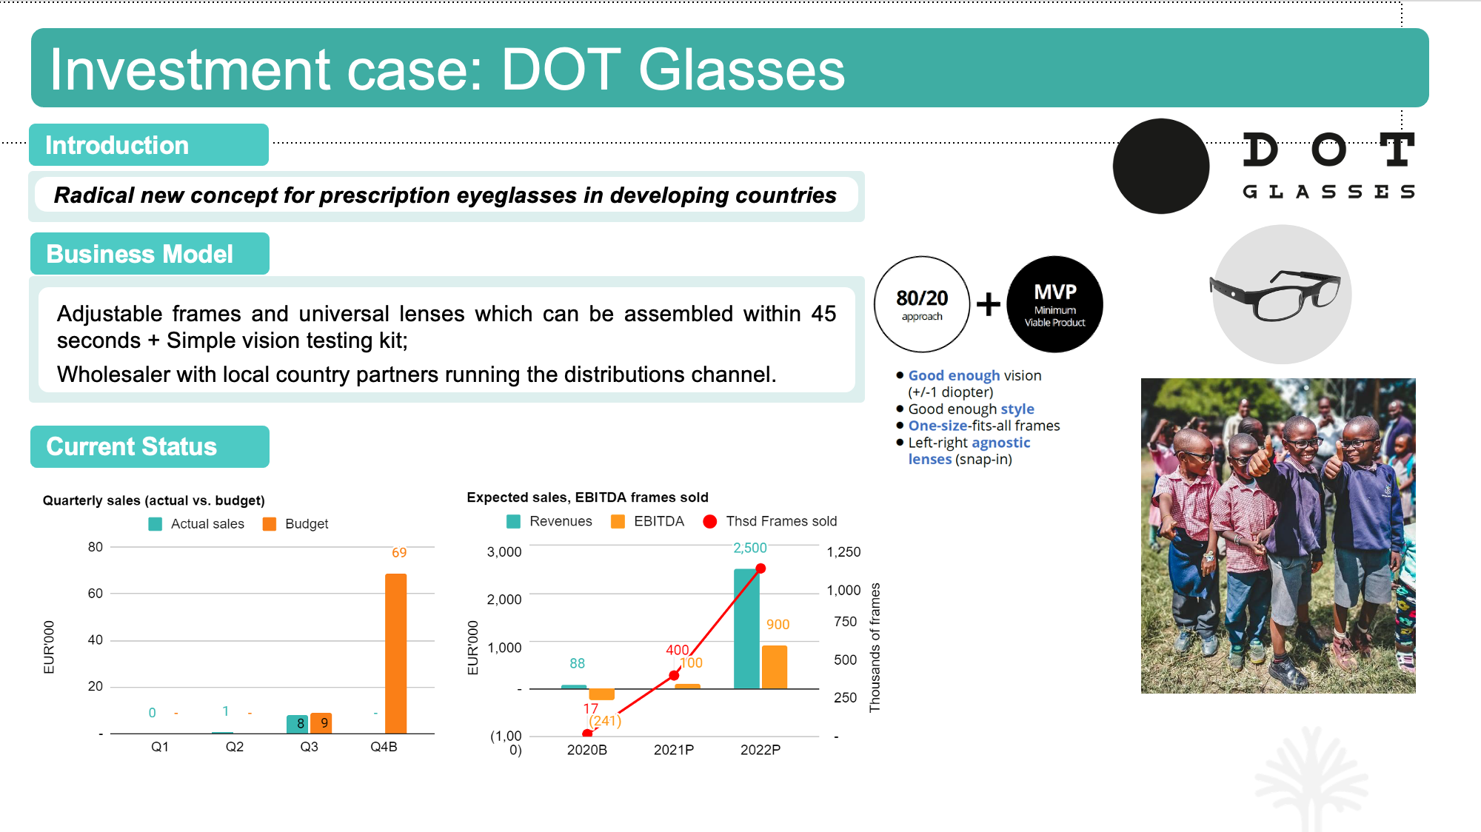

Slide 10
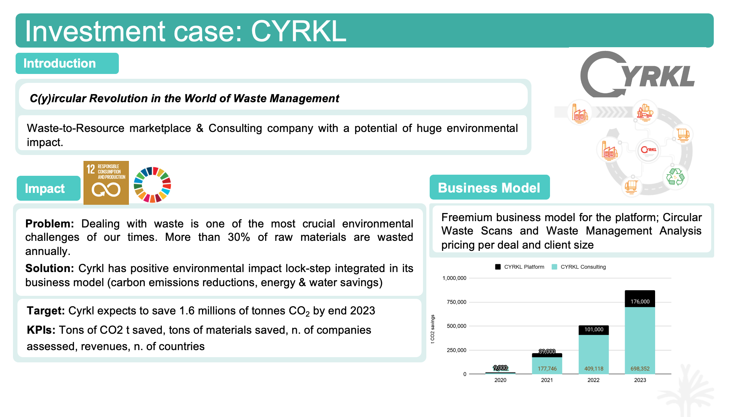

Slide 11


